Slide 1

Agenda:
Welcome/ Intro
Connections/ View Shed Exercise
Community Priorities- Rank Vote
Visual Representation- Zoning
Growth & Resiliency
OEDIT Resiliency Report
Sales Tax Data
Town Center Place Making Charrette- Portmanteau

Slide 2

Community Priorities- Rank Vote
Elevated Architecture (Mtn. Lakestyle)
Develop Third Spaces/Public Realm Gathering Places.
Year-Round Residential
Destination Visitors
Attainable Housing
Diversifying Tax Base
Narrow Lake Dillon Drive
360 Views
Connection to Waterfront
Connections to Greater Dillon
Public Amenities & Parks
Marina Improvements
Walkable
Supporting Locally Owned
Events
Amphitheater
Farmers Market
Drive Market Visitors
Creating More Jobs
Notes:
Street improvements are reconstructions
Ensign Dr, Corinthian Cr, West Buffalo, Three Rivers, West LaBonte, lower Tenderfoot, Gold Run
Park Improvements
Marina Park playground, pavilion, landscaping, parking
Marina parking lot
Electronic sign board
Pavement maintenance – overlays, chip seals
Building improvements – ADA compliance, town hall remodels, maintenance shop
Revitalization projects – street lights, banners
Miscellaneous projects – wall failure on Little Beaver Trail
Debt payments – equipment loans issued in 2006 and 2009, paid off in 2016 and 2014

Slide 3
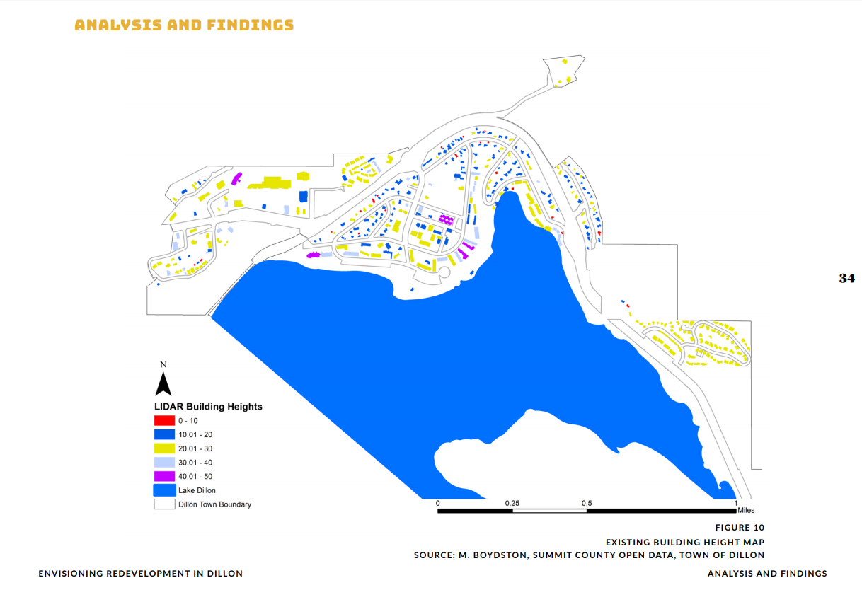

Slide 4
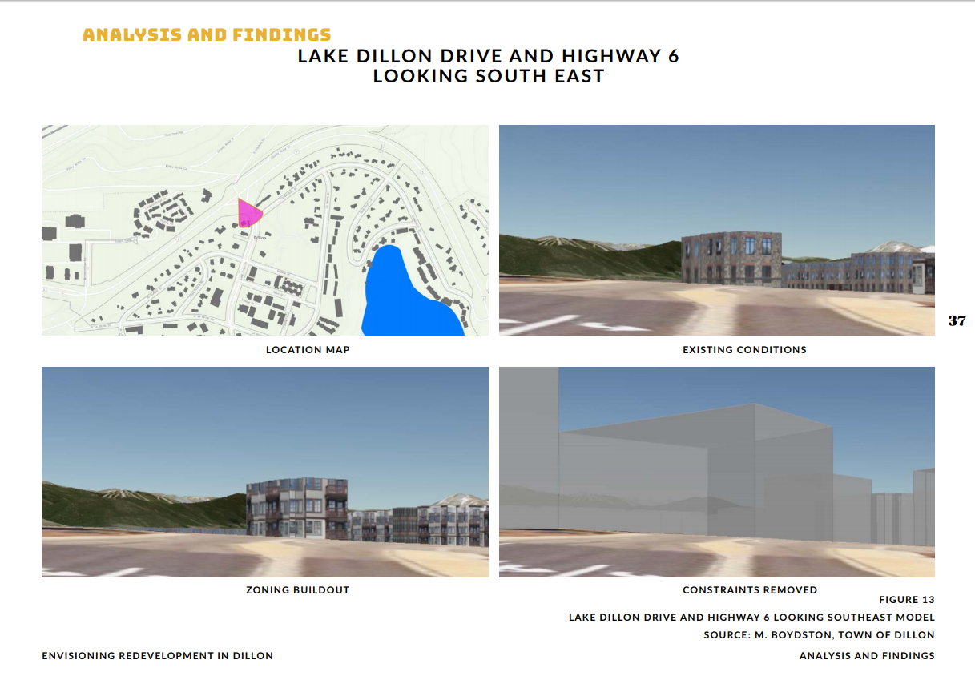

Slide 5
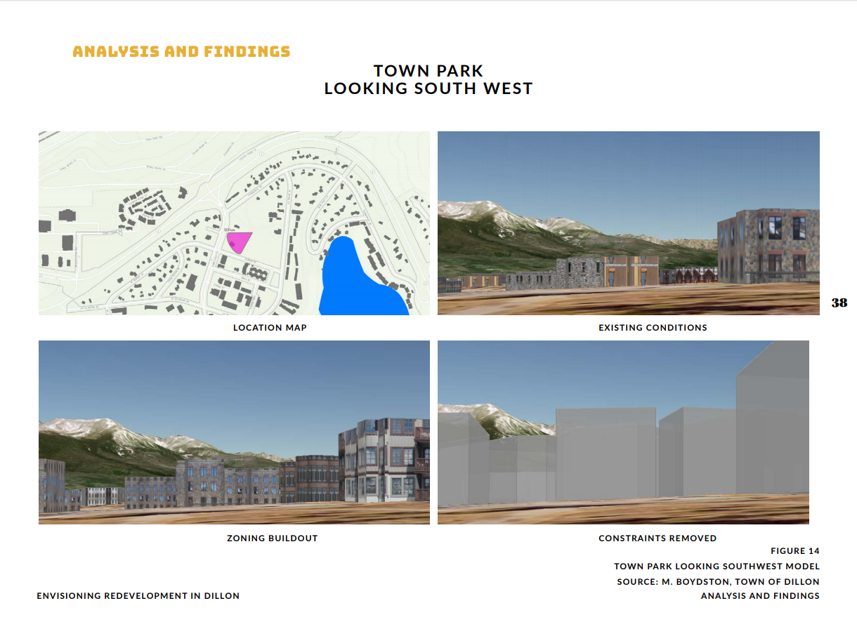

Slide 6
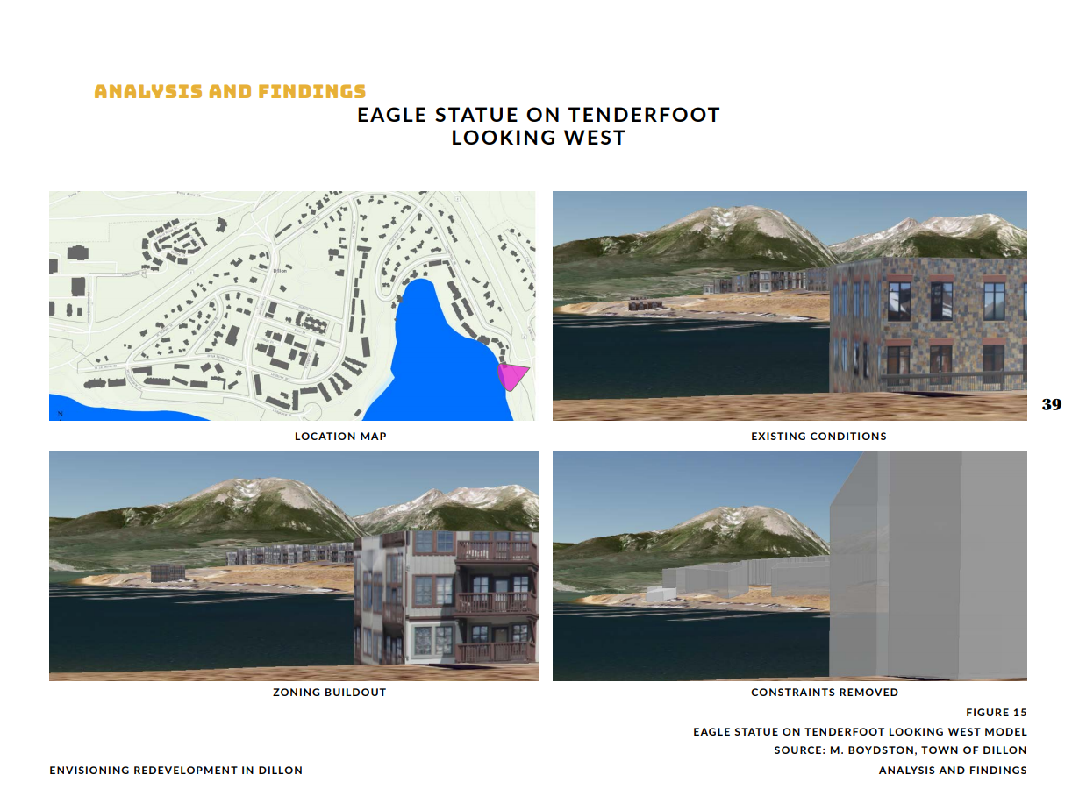

Slide 7
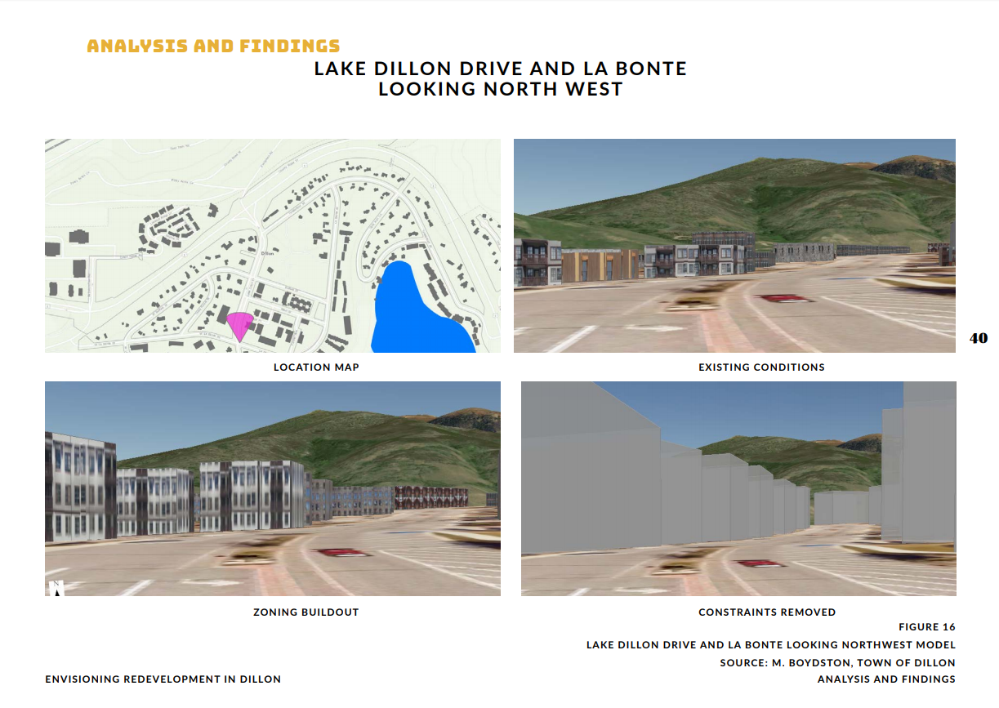

Slide 8


Slide 9
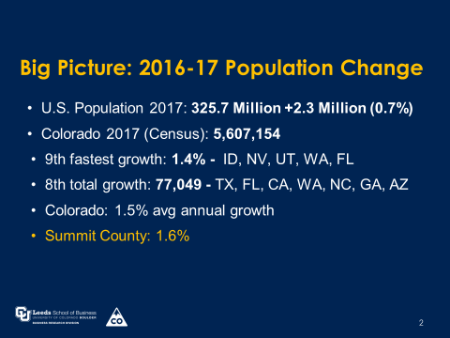

Slide 10
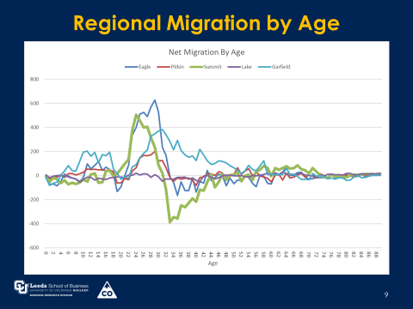

Slide 11
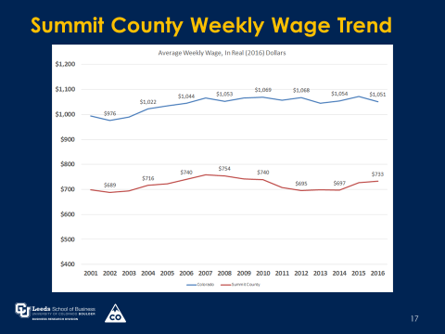

Slide 13
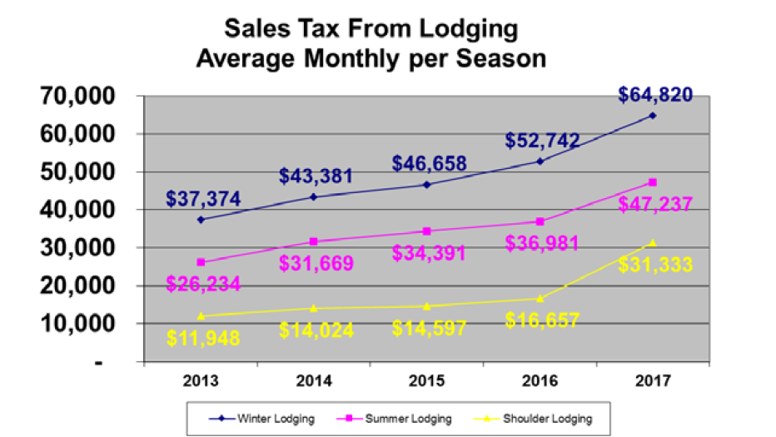

Slide 14
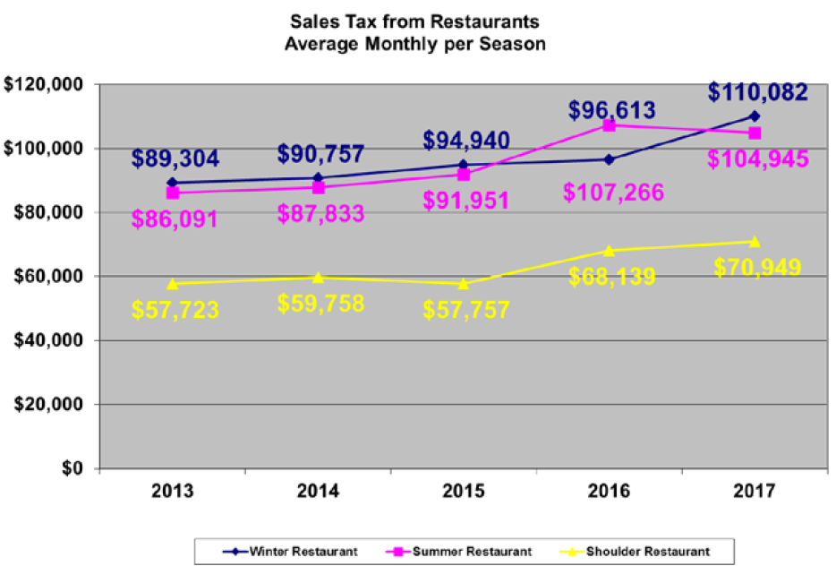

Slide 15
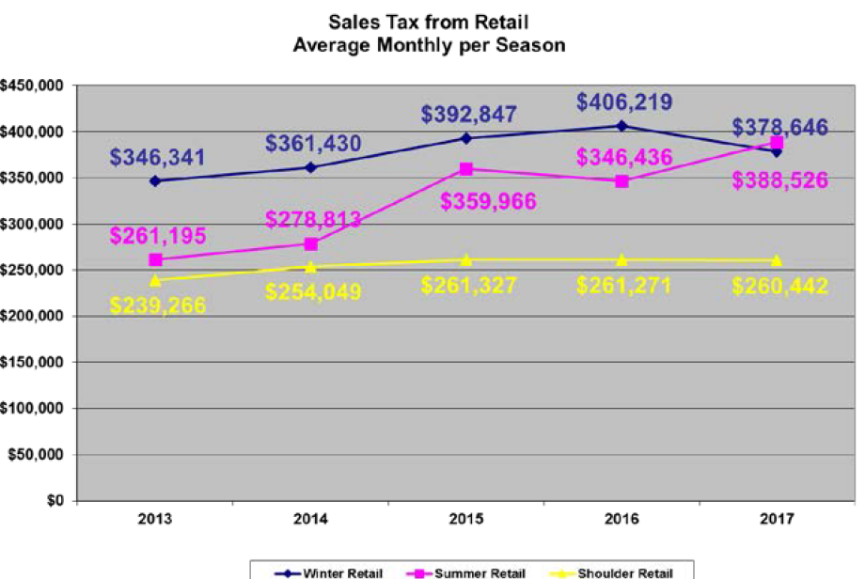

Slide 16
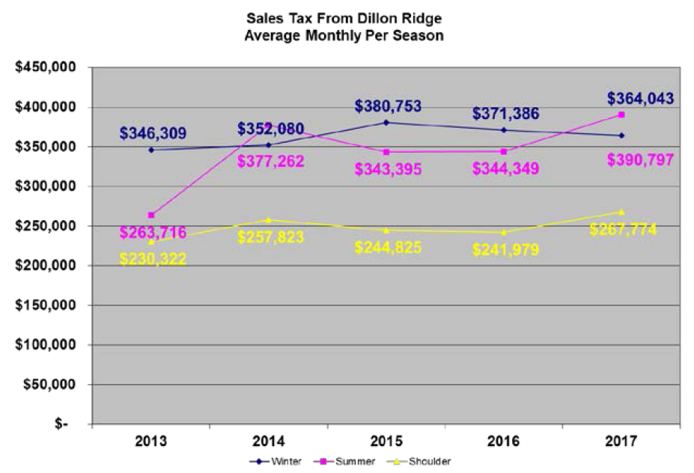

Slide 17
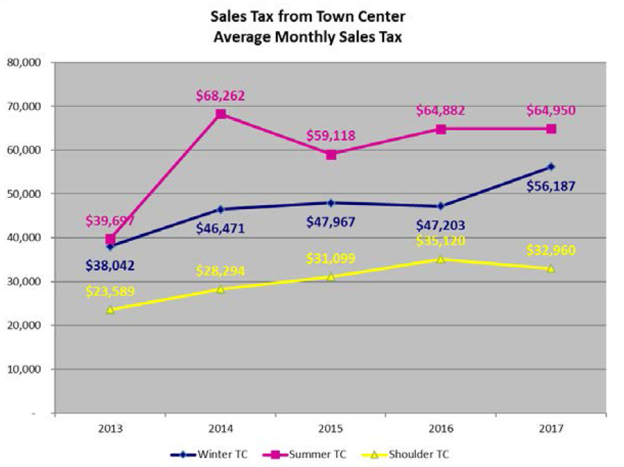

Slide 18
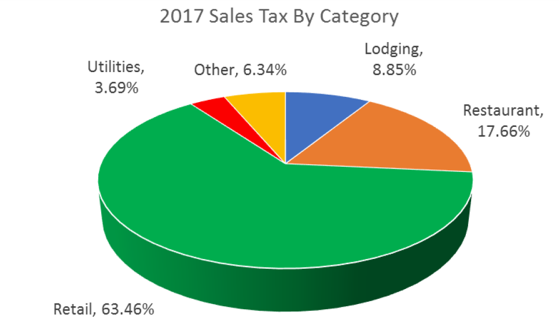

Slide 19
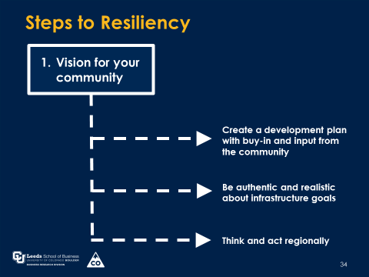

Slide 20
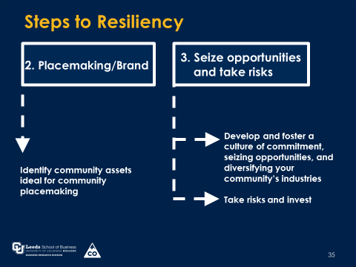

Slide 21
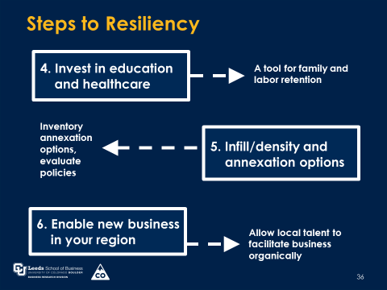

Slide 22
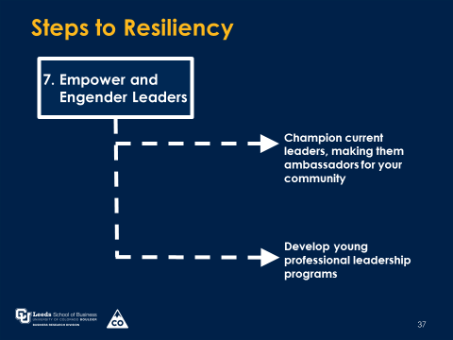

Slide 23
Appendix

Slide 24
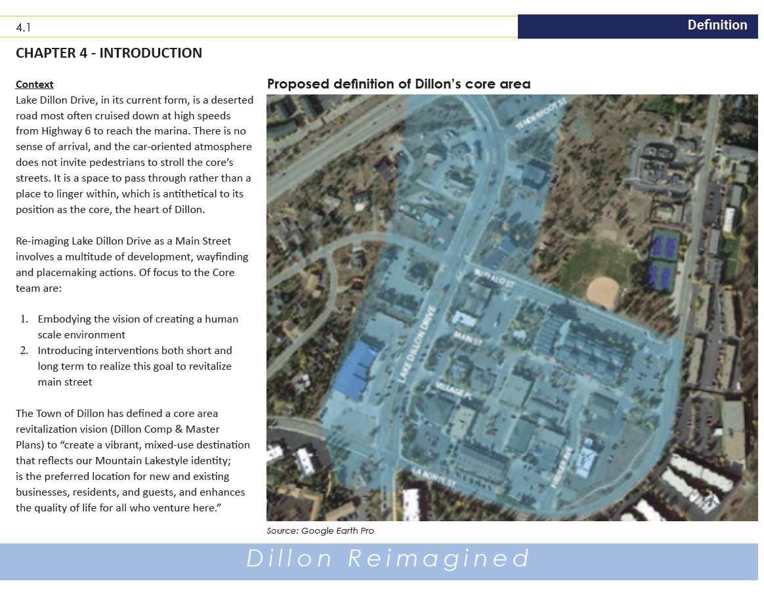

Slide 25
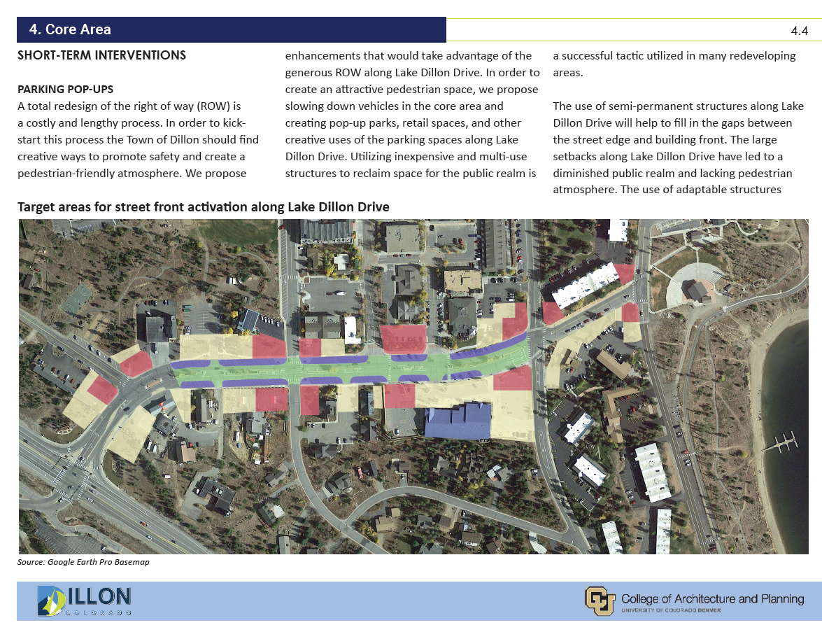

Slide 26
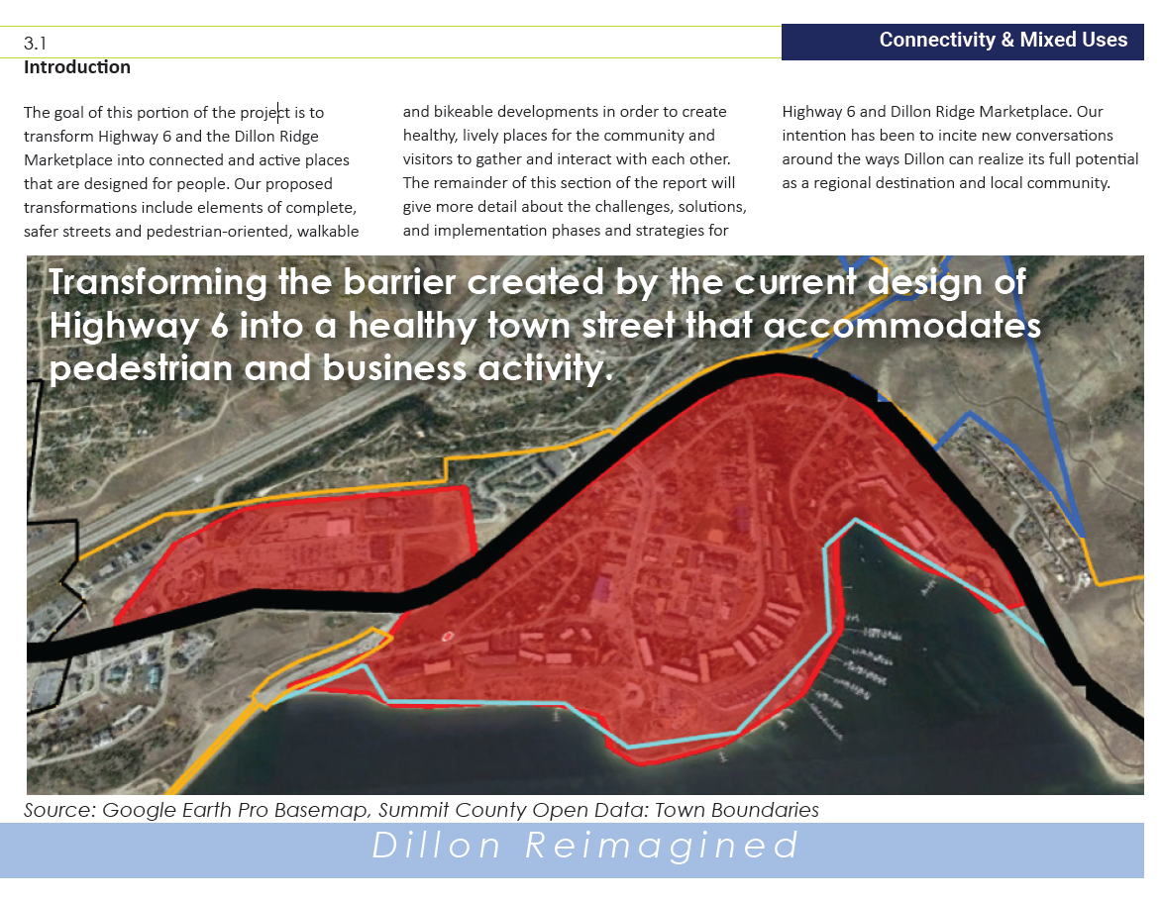

Slide 27
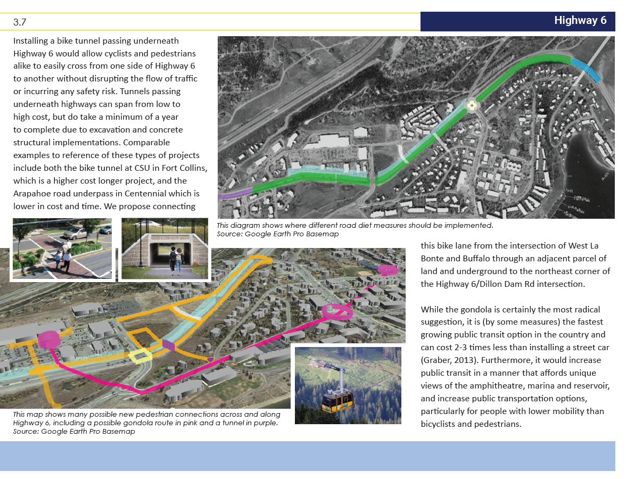

Slide 28
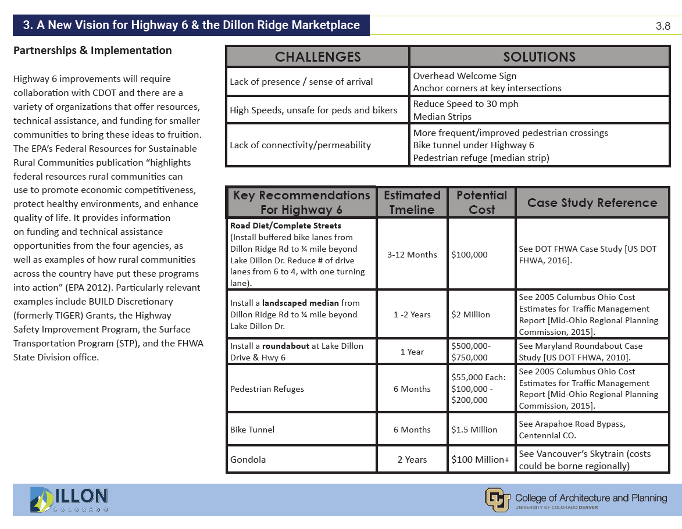

Slide 29
